Slide 1
Western European philosophy of “New time”. Philosophy of Enlightenment period

Slide 2
Enlightenment
Enlightenment - an intellectual movement, developed mainly in France, Britain and Germany, which advocated freedom, democracy and reason as the primary values of society. Philosophers of the Enlightenment were "radical" thinkers who attempted to apply the principals of reason and scientific method (that came out of the Scientific Revolution) to all aspects of Society. Philosophers of the Enlightenment had an enormous impact on the French Revolution. Age of Reason

Slide 3
Background: 17th century
clear separation of philosophy and religion
important philosophers:
Rene Descartes
made a distinct difference in matters of reason and matters of faith
Baruch Spinoza
thought God and nature were one

Slide 4
Pre-Enlightenment Religion and 18th century Philosophy
18th century Philosophy
pre-enlightenment religion heavily relied on God and did not ask many questions about religions
in the 18th century, nontraditional thinkers became known as philosophers
they were adamant about questioning the things around them especially government; therefore they no longer tolerated oppressive governments

Slide 5
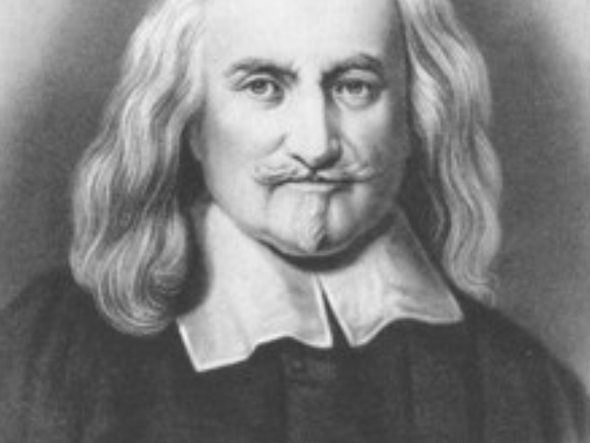
Thomas Hobbes
Philosophy
All humans are naturally selfish and wicked
Desired Actions:
People should give up their rights to a stronger ruler.
Social Contract-people give up their rights to ruler with absolute power

Slide 6

John Locke
Philosophy
People were naturally good
Reason allowed people to self govern
Desired Actions
Natural rights-life, liberty and propery
believed in democracy & self-government
Government's power came from the people

Slide 7
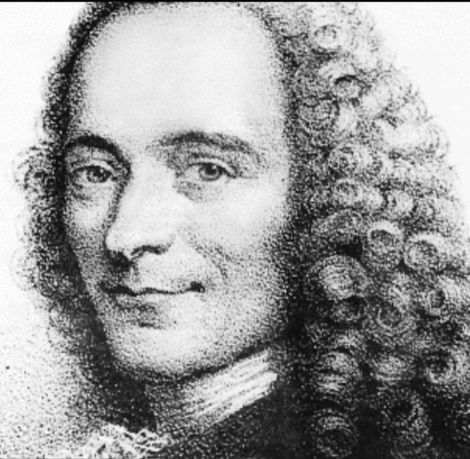
Voltaire
Philosophy
used writing to criticize intolerance
spoke out against government
Desired Actions
Religous freedom
Freedom of Speech

Slide 8
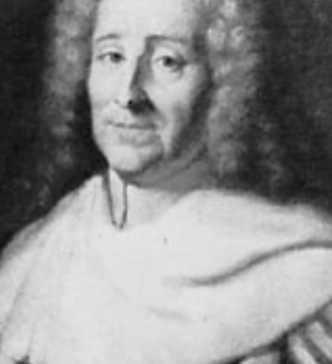
Montesquieu
Philosophy
Balance of Power
Checks & Balances of branches of government
Desired Actions
Separate of Powers
Legislative, Executive, Judicial

Slide 9
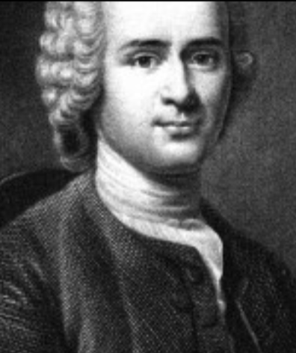
Rousseau
Philosophy
Individual Freedome
Society destroys freedom and equality
Desired actions
wanted a society in which all people were equal

Slide 10
Western European philosophy of “New time”.
In the second half of the 19th century, the transition to non-classical philosophy is gradually being prepared, there is a departure from the classics, a change of principles, models, and philosophizing paradigms is taking place.
Classical philosophy believed that the mind is the main and best tool for transforming human life
Classical philosophical constructions did not satisfy many philosophers because they considered the loss of man in them.

Slide 11
In contrast to rationalism, non-classical philosophy was developed.
-life (the philosophy of life)
-the existence of man (existentialism) began to be represented as primary reality.
*The “destruction” of the mind happened: instead of the mind, the will came to the fores and instincts

Slide 12
Development and fall
neorealism
Pragmatism
existentialism
phenomenology
Tomism
Рoststructuralism
neorealism
Pragmatism

Slide 13
Summary
Enlightenment thinkers - helped spread the idea of progress by using reason; helped make the world less religious and more wordly and stressed the importance of the individual. The period was marked by a further decline in the influence of the church, governmental consolidation and greater rights for the common people.

Slide 14
Questions
Which Enlightened Philosophe do you most agree with? Why?
What is the difference between this period and previous ones?
How do you feel about the philosophy of this period?

